Slide 1

Charn Prediction

Slide 2
Agenda:
The quick intro about our team
What is Customer Charn Prediction ?
A little bit about our data set
Data preprocessing steps
About the selection of algotithms
The bottom line of our work

Slide 3



Team members:
Daulet
Bulgyn
Tolkyn

Slide 4

What is Customer Charn Prediction?
Customer churn is a tendency of customers to abandon a brand and stop being a paying client of a particular business. In another words it is customer attrition.
Why is it important?
By leveraging the data about customers, you can identify behavior of customers who are likely to churn. This information let you make prediction to the future regarding the profit etc.

Slide 5
The aim of the our research:
What we are going to predict ?
How we going to do it ?
Why it is important ?

Slide 6
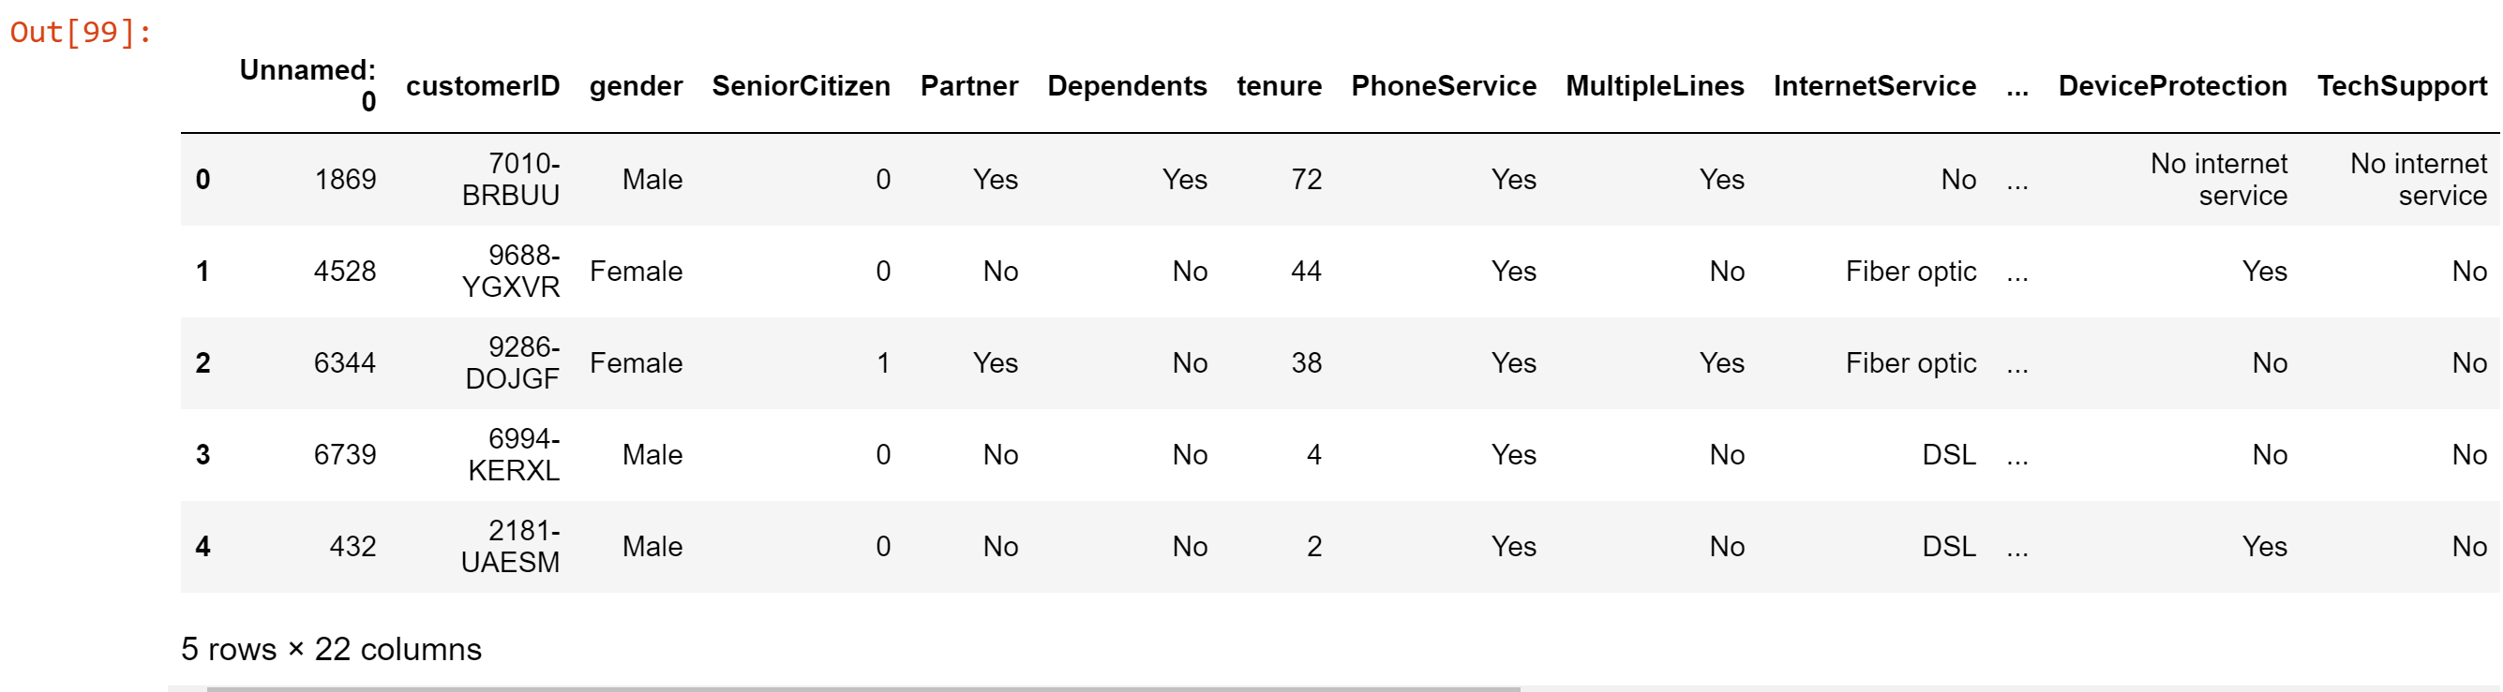
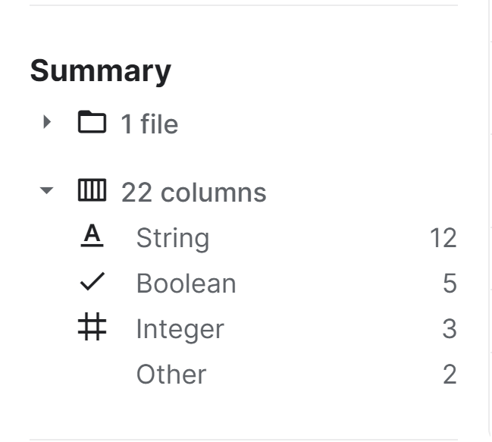
About data source
Link to the our dataset: https://www.kaggle.com/radmirzosimov/telecom-users-dataset

Slide 7
Data analyzing
Types of data
A lot of visuals
What and how to edit ?
Before preprocessing we should to analyze what we have

Slide 8
Data preprocessing step:
Types of data manipulation
Why do we need it ?

Slide 9
About used algorithms type
Results of algorithms

Slide 10
Conclusion, by results, and why we chose it ?

